Slide 1

DESIGN PROJECT 3:WEEKLY PROGRESS 4
TICKET VERIFIER
PASSY MUKUNA LUFULUABO
Student Number :215270835
Lecturer/Supervisor: V Moyo
Date: 07/04/2019

Slide 2
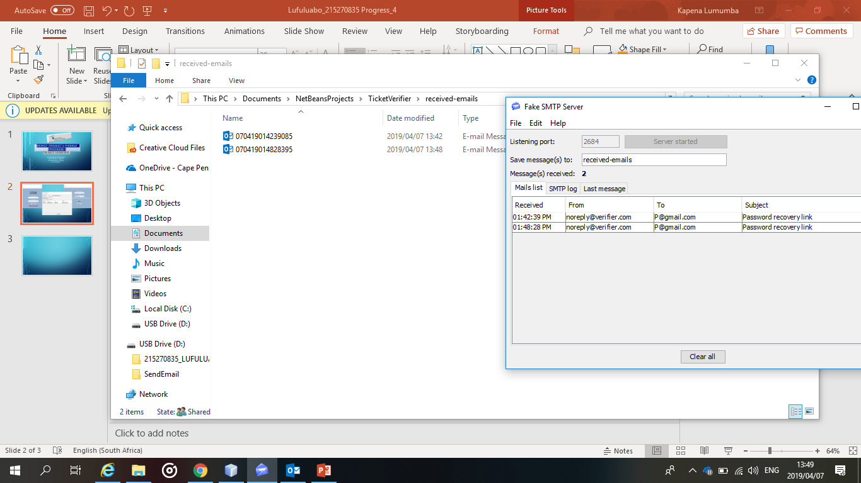
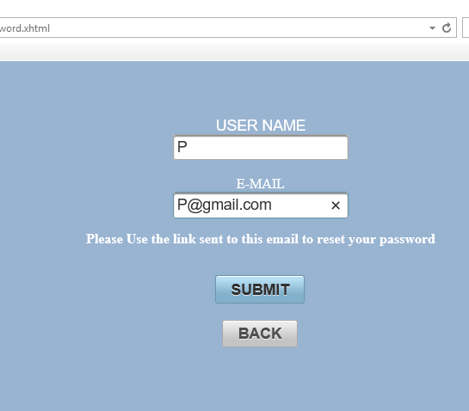
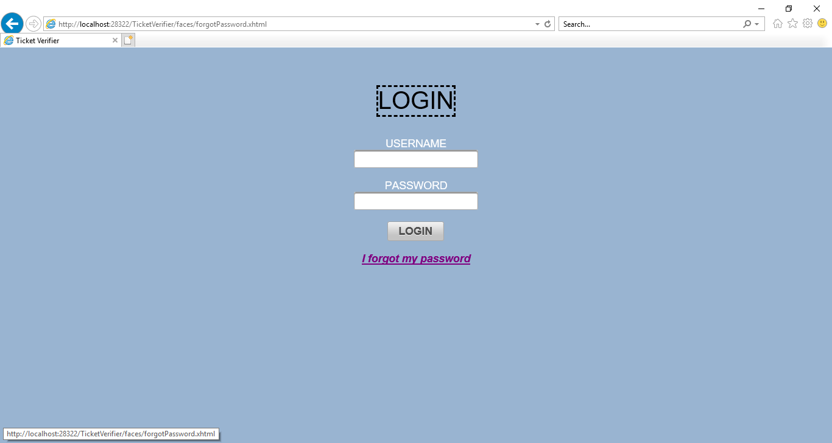
I have done the forgotpassword. When a user forgot hispassword, he can use this page to reset it.
So it is going to send a link to the user email, that will redirect to the password recovery page

Slide 3
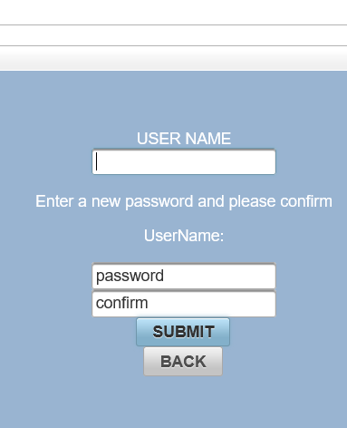
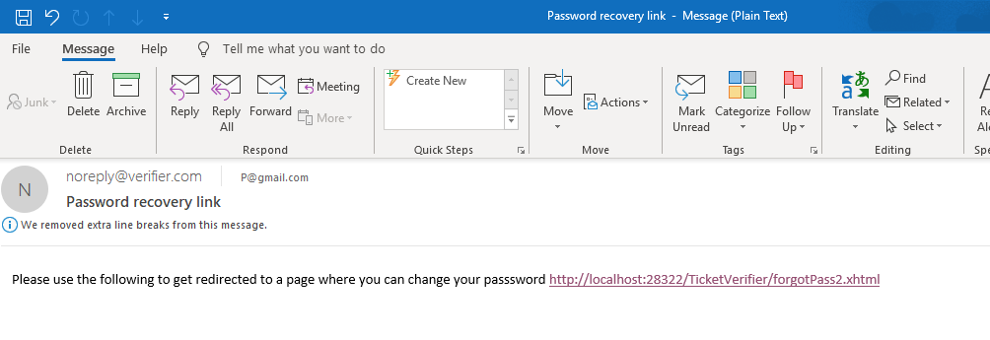
The page where you will be redirected to reset the password
But I am getting a problem, I am being unable to get redirected after clicking the link, I will have to fix that
This is the email, when opened.

